Slide 1
Test Execution

Slide 2
Learning objectives
Appreciate the purpose of test automation
  Factoring repetitive, mechanical tasks from creative, human design tasks in testing
Recognize main kinds and components of test scaffolding
Understand some key dimensions in test automation design
  Design for testability: Controllability and observability
  Degrees of generality in drivers and stubs
  Comparison-based oracles and self-checks

Slide 3
Automating Test Execution
Designing test cases and test suites is creative
  Like any design activity: A demanding intellectual activity, requiring human judgment
Executing test cases should be automatic
  Design once, execute many times
Test automation separates the creative human process from the mechanical process of test execution

Slide 4
Generation: From Test Case Specifications to Test Cases
Test design often yields test case specifications, rather than concrete data
  Ex: “a large positive number”, not 420023
  Ex: “a sorted sequence, length > 2”, not “Alpha, Beta, Chi, Omega”
Other details for execution may be omitted
Generation creates concrete, executable test cases from test case specifications

Slide 5

Example Tool Chain for Test Case Generation & Execution
We could combine ...
  A combinatorial test case generation (like genpairs.py) to create test data
    Optional: Constraint-based data generator to “concretize” individual values, e.g., from “positive integer” to 42
  DDSteps to convert from spreadsheet data to JUnit test cases
  JUnit to execute concrete test cases
Many other tool chains are possible ...
  depending on application domain
Photo: (c) Scott Robinson (clearlyambiguous on Flickr) , creative commons attribution license
Notes:
See:
http://www.ddsteps.org/
http://www.junit.org/
http://www.pairwise.org/
(or obtain genpairs.py from the authors)
Photo credit: clearlyambiguous (Scott Robinson) on Flickr.com, some rights reserved: Creative Commons attribution license
http://www.flickr.com/photos/clearlyambiguous/46191139

Slide 6
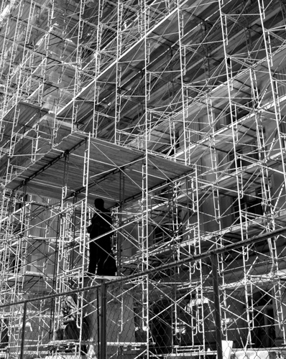
Scaffolding
Code produced to support development activities (especially testing)
  Not part of the “product” as seen by the end user
  May be temporary (like scaffolding in construction of buildings
Includes
  Test harnesses, drivers, and stubs
Image by Kevin Dooley under Creative Commons license
Notes:
Image by Kevin Dooley under Creative Commons license
http://flickr.com/photos/12836528@N00/2201791390/
Interestingly, the Flickr website of Kevin Dooley, who took the picture we selected to illustrate the concept, contains a description that is precisely apropos:
In complex systems science, "scaffolding" are those structures necessary to move from an initial state to an emerged form. For example, when recapturing an area of land and bringing it back to its natural state (e.g. prairie), you will find that certain birds and plants have to be present during the transition time in order for the old form to re-emerge. Once the new state has emerged, the scaffolding comes down... BUT, without the scaffolding, no change would have occurred.

Slide 7
Scaffolding ...
Test driver
  A “main” program for running a test
    May be produced before a “real” main program
    Provides more control than the “real” main program
      To driver program under test through test cases
Test stubs
  Substitute for called functions/methods/objects
Test harness
  Substitutes for other parts of the deployed environment
    Ex: Software simulation of a hardware device
Notes:
Terminology note: “Harness” is also commonly used to refer to all three parts, a test driver, stubs, and replacements for other components.

Slide 8
Controllability & Observability
GUI input (MVC “Controller”)
Example: We want automated tests, but interactive input provides limited control and graphical output provides limited observability
Program Functionality
Graphical ouput (MVC “View”)

Slide 9
Controllability & Observability
GUI input (MVC “Controller”)
Test driver
API
Program Functionality
Log behavior
Capture wrapper
A design for automated test includes provides interfaces for control (API) and observation (wrapper on ouput).
Graphical ouput (MVC “View”)

Slide 10
Generic or Specific?
How general should scaffolding be?
  We could build a driver and stubs for each test case
  ... or at least factor out some common code of the driver and test management (e.g., JUnit)
  ... or further factor out some common support code, to drive a large number of test cases from data (as in DDSteps)
  ... or further, generate the data automatically from a more abstract model (e.g., network traffic model)
A question of costs and re-use
  Just as for other kinds of software

Slide 11
Oracles
Did this test case succeed, or fail?
  No use running 10,000 test cases automatically if the results must be checked by hand!
Range of specific to general, again
  ex. JUnit: Specific oracle (“assert”) coded by hand in each test case
  Typical approach: “comparison-based” oracle with predicted output value
  Not the only approach!

Slide 12
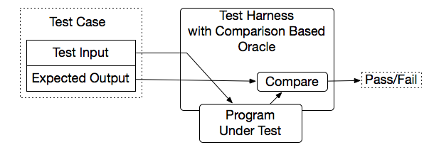
Comparison-based oracle
With a comparison-based oracle, we need predicted output for each input
  Oracle compares actual to predicted output, and reports failure if they differ
Fine for a small number of hand-generated test cases
  E.g., for hand-written JUnit test cases

Slide 13
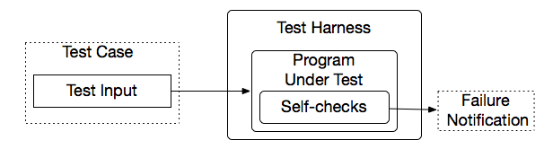
Self-Checking Code as Oracle
An oracle can also be written as self-checks
  Often possible to judge correctness without predicting results
Advantages and limits: Usable with large, automatically generated test suites, but often only a partial check
  e.g., structural invariants of data structures
  recognize many or most failures, but not all
Notes:
A typical approach is to add a few hand-written test cases with a comparison-based test oracle, to cover properties that are difficult or too expensive to check with a general oracle.

Slide 14
Capture and Replay
Sometimes there is no alternative to human input and observation
  Even if we separate testing program functionality from GUI, some testing of the GUI is required
We can at least cut repetition of human testing
Capture a manually run test case, replay it automatically
  with a comparison-based test oracle: behavior same as previously accepted behavior
    reusable only until a program change invalidates it
    lifetime depends on abstraction level of input and output

Slide 15
Summary
Goal: Separate creative task of test design from mechanical task of test execution
  Enable generation and execution of large test suites
  Re-execute test suites frequently (e.g., nightly or after each program change)
Scaffolding: Code to support development and testing
  Test drivers, stubs, harness, including oracles
  Ranging from individual, hand-written test case drivers to automatic generation and testing of large test suites
  Capture/replay where human interaction is required

